Slide 1

Pico Balloons
By AAØO
SPARC
Sept 2026
Presentation skewed to the top for the club projector
Notes:
Saw presenation at dayton 2022 by Bill Brown WB8ELK

Slide 2
What is Pico Ballooning?
Launching very small, lightweight high-altitude balloons
Typically uses inexpensive foil party balloons
Carries a tiny solar-powered radio tracker
Often weighs less than 20 grams
Flies in the stratosphere, usually around 30,000–45,000 feet
Transmits position and telemetry using amateur radio
Can stay airborne for days, weeks, or even months
With favorable winds, a balloon may circle the globe
Each transmission reports GPS position, altitude, temperature, voltage
WHY?

Slide 3
Is it legal?
Notes:
FAA, regulations start at 4lbs
FL, 2024
0.027% chance it lands in FL, 1 in 3670, 100ft sq it launched from, 1 in 549 billion
Nk, ukr jam
Military tracking via websites

Slide 4

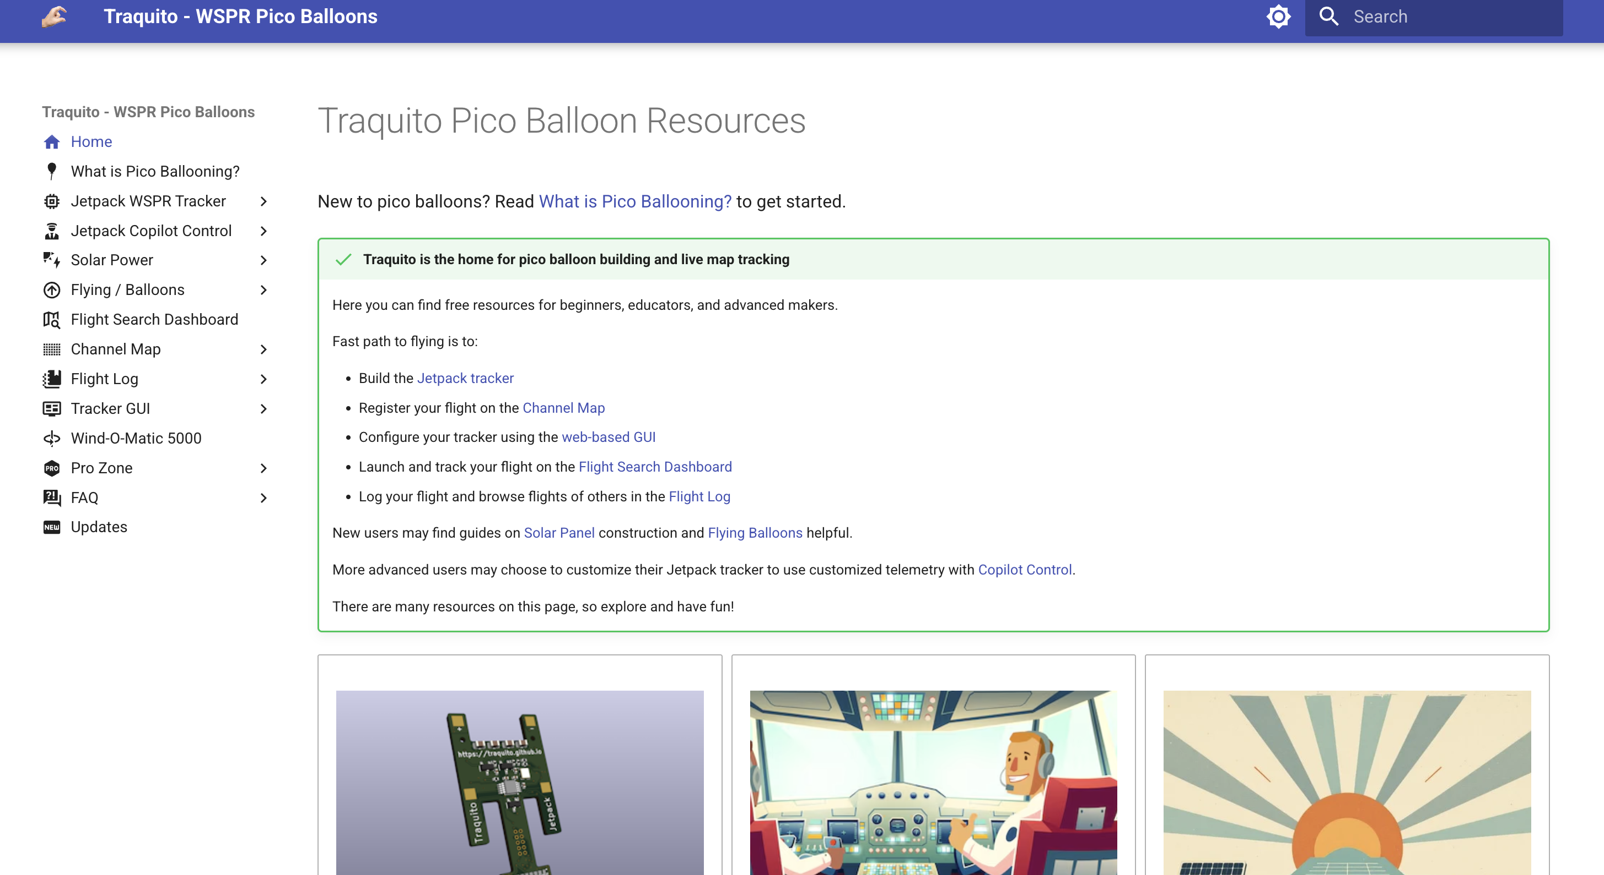
How?
https://traquito.github.io/

Slide 5

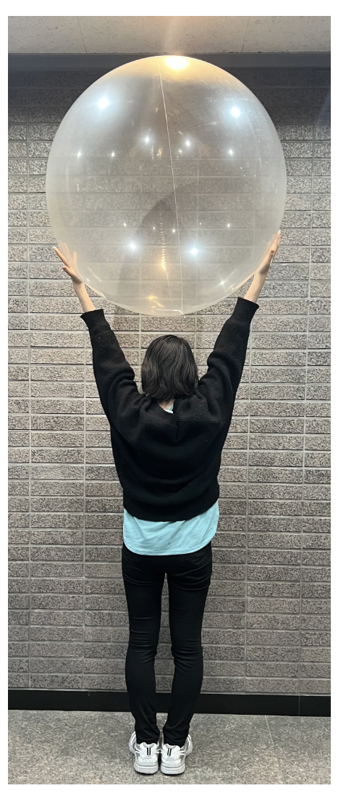
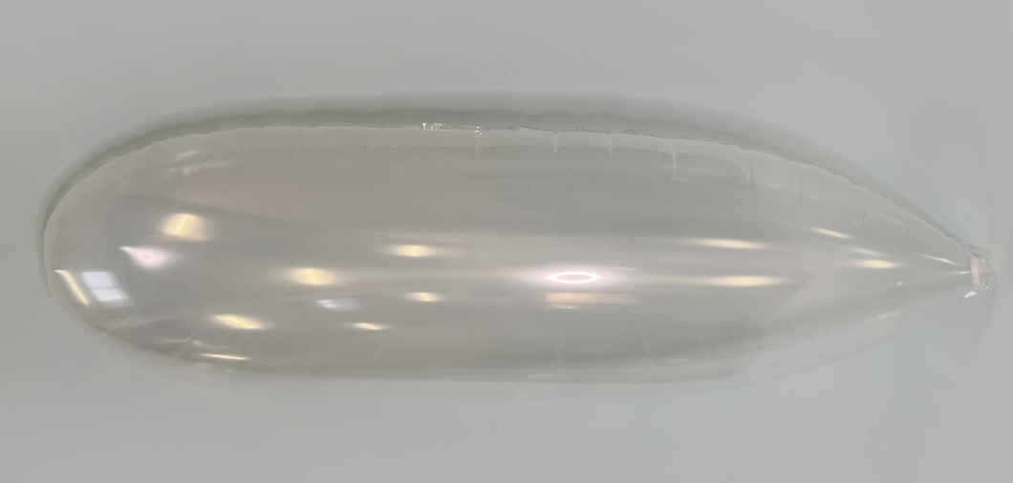
Balloons
Yokohama Balloon – Japan
10 for $250
Windreiter – Germany
60 euro + shipping
PartyWoo – Amazon 3 for $9
Notes:
Start at the top

Slide 6

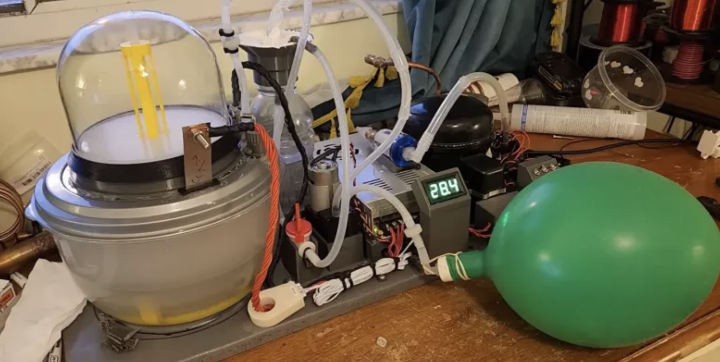
Balloon gas
Helium – Balloon Time
Walmart $60 for 13L
Approx 10 launches
80%+
Hydrogen – more lift, more dangerous, more $

Slide 7
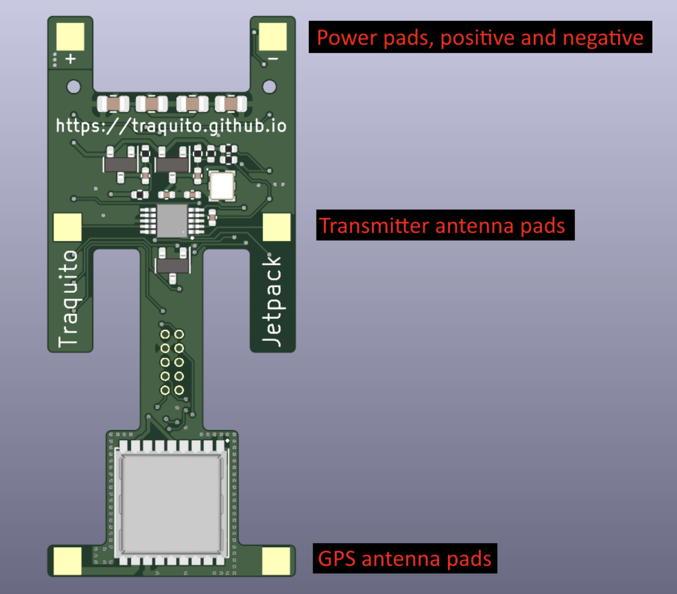
Tracker
Traquito Jetpack
Order from JLCPCB ~$96 for 10
Provides GPS
Transmitter SI5351A
Solar voltage monitor
Solders onto Raspberry Pi Pico $4
  RP2040 CPU
  Flash Memory
  Temperature sensor
  USB and support for Drag/Drop software upload
Notes:
Drop firmware into drive via usb then program on traquito website with callsign and channel
$96 shipped for 10 plus 30 solar frames, more now due to tarriffs
Total $3 balloon, $6 gas, $14 tracker, $1/$15 solar, $24 or $38/launch, not counting wire/tape

Slide 8
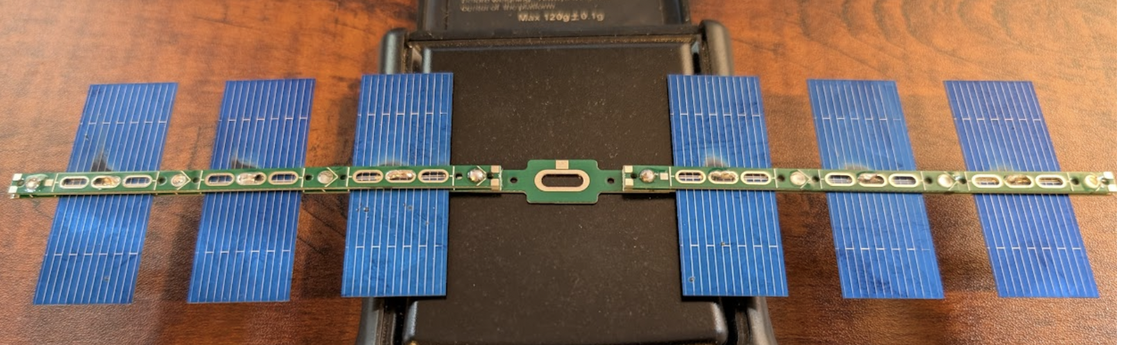
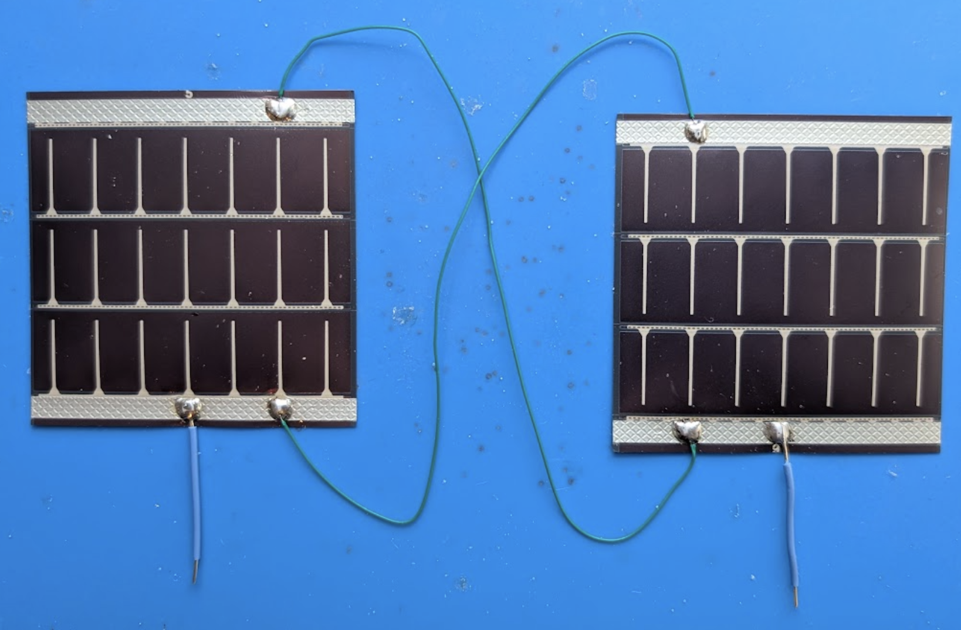
SOLAR POWER
Traquito Solar System
Stupidly fragile
Around $1
Better solar angle
Power Film
Not fragile
$15
Less angle

Slide 9
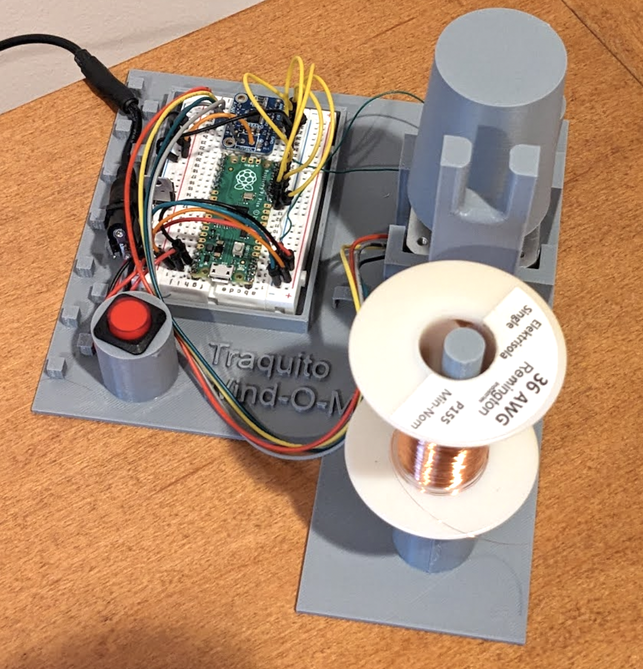
Antenna
Traquito
WIND-O-MATIC 5000
Approx $40
36 AWG Magnet wire
199in for 20m
Notes:
Toilet paper roll

Slide 10
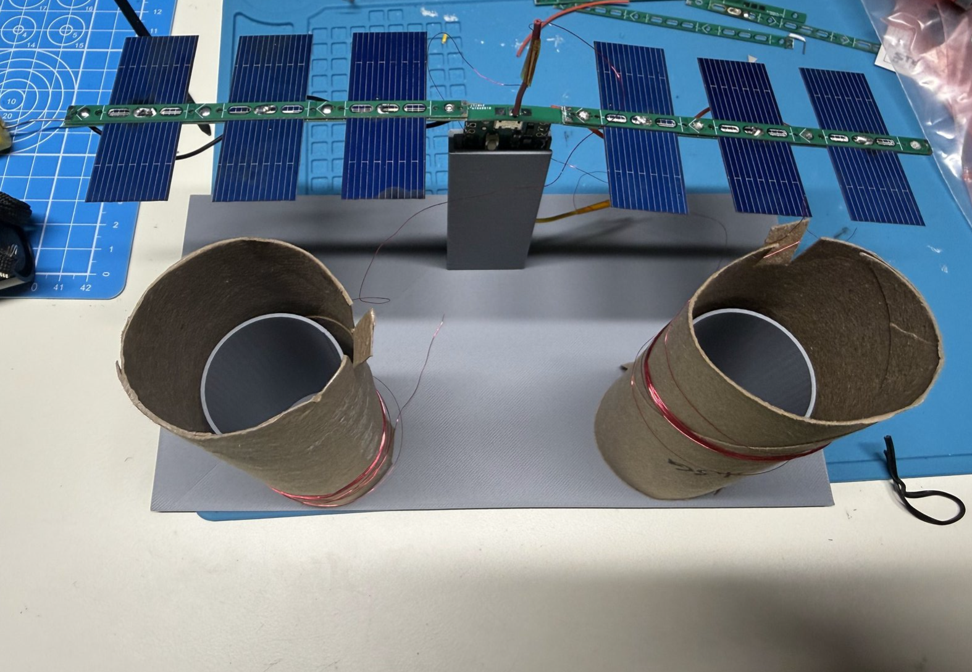
Notes:
Strain relief on top

Slide 11
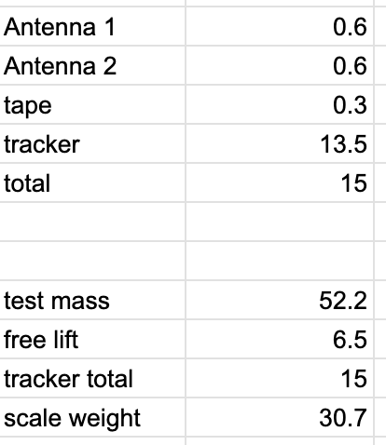
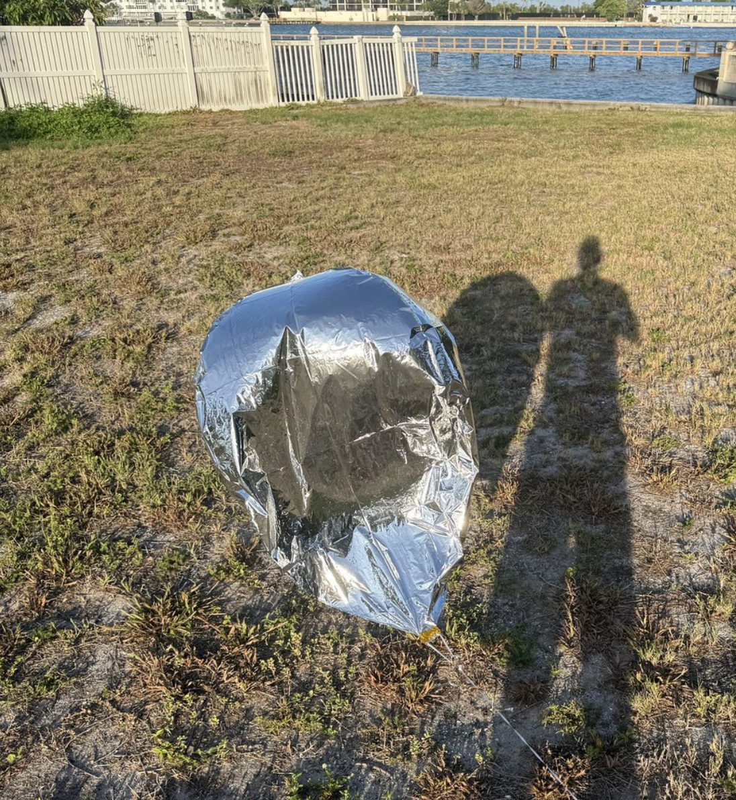
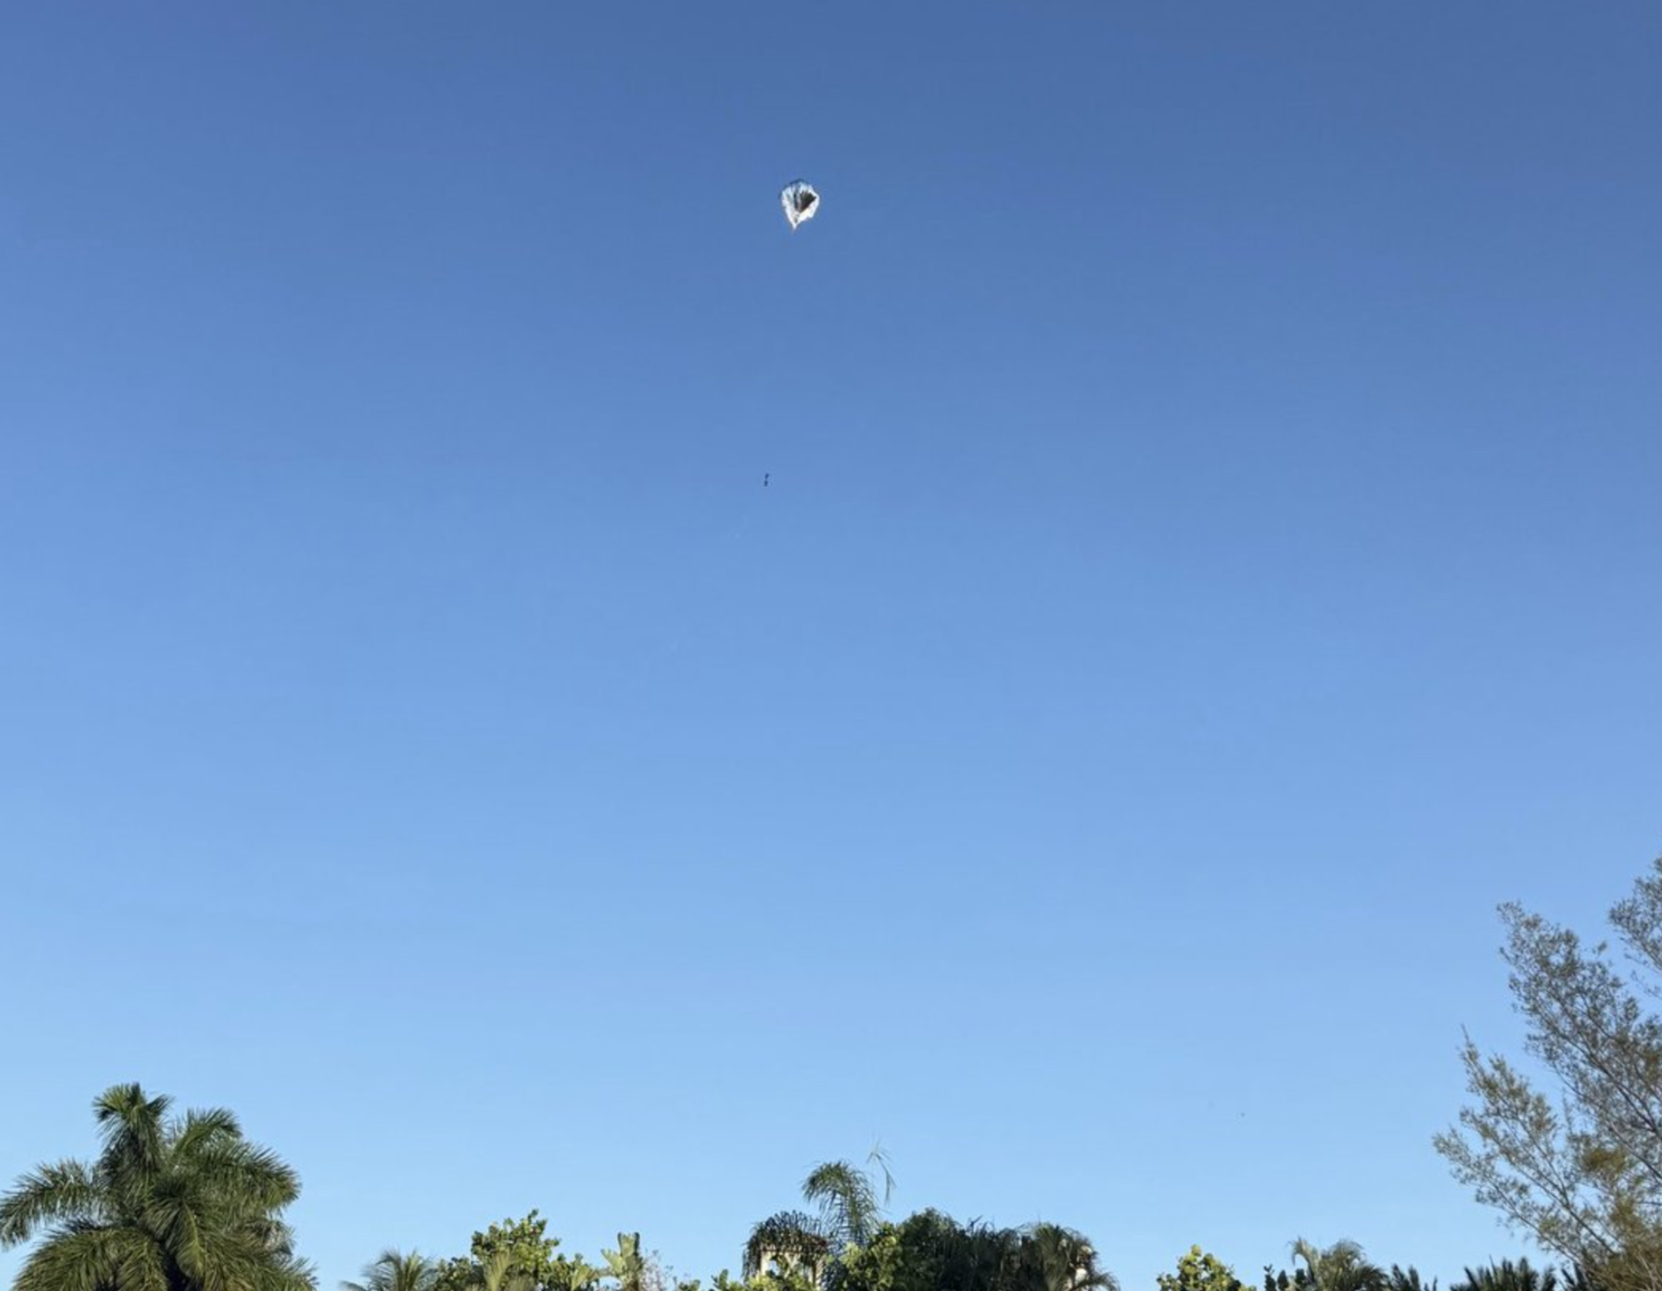
LAUNCHING
Calculate lift 5-7g
No powerlines
Low wind or big open area
Notes:
Use 50g approx weight and scale and add helium until desired lift achieved
Morning launch didn't get spots until 3 hours later due to sun
Ribbon from balloon gas kit, roll out antenna, cut and walk back to tracker then release

Slide 12

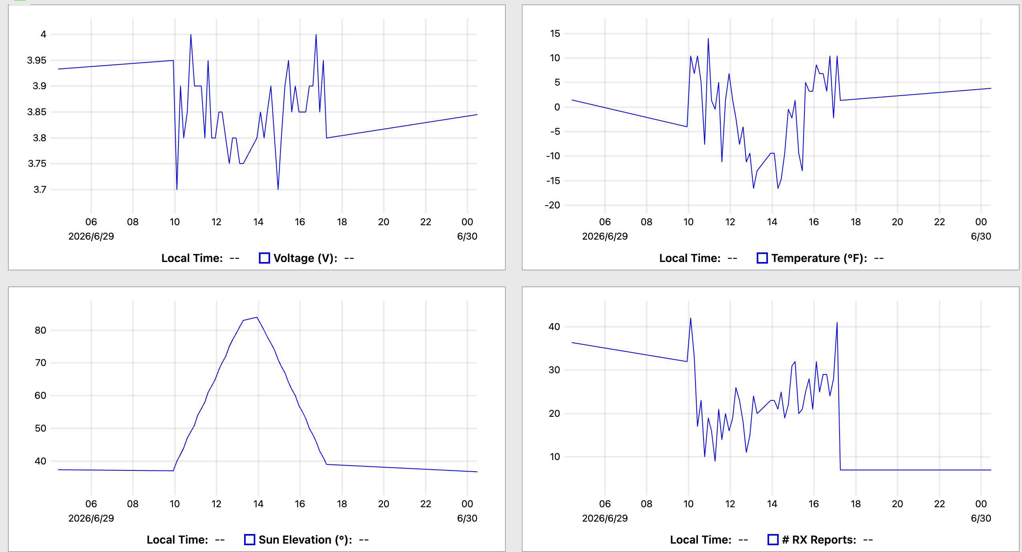
TRACKING
Uses WSPR
No spots at night
Traquito site
WSPRTV.com

Slide 13
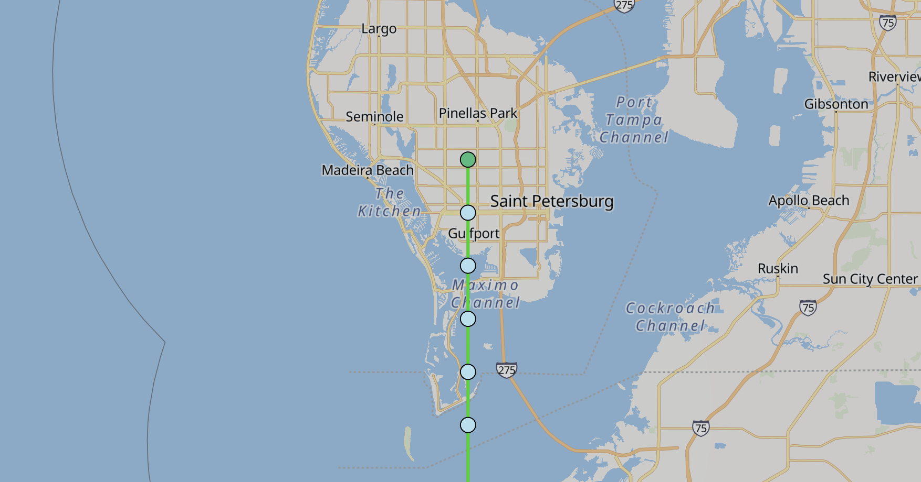

Slide 14
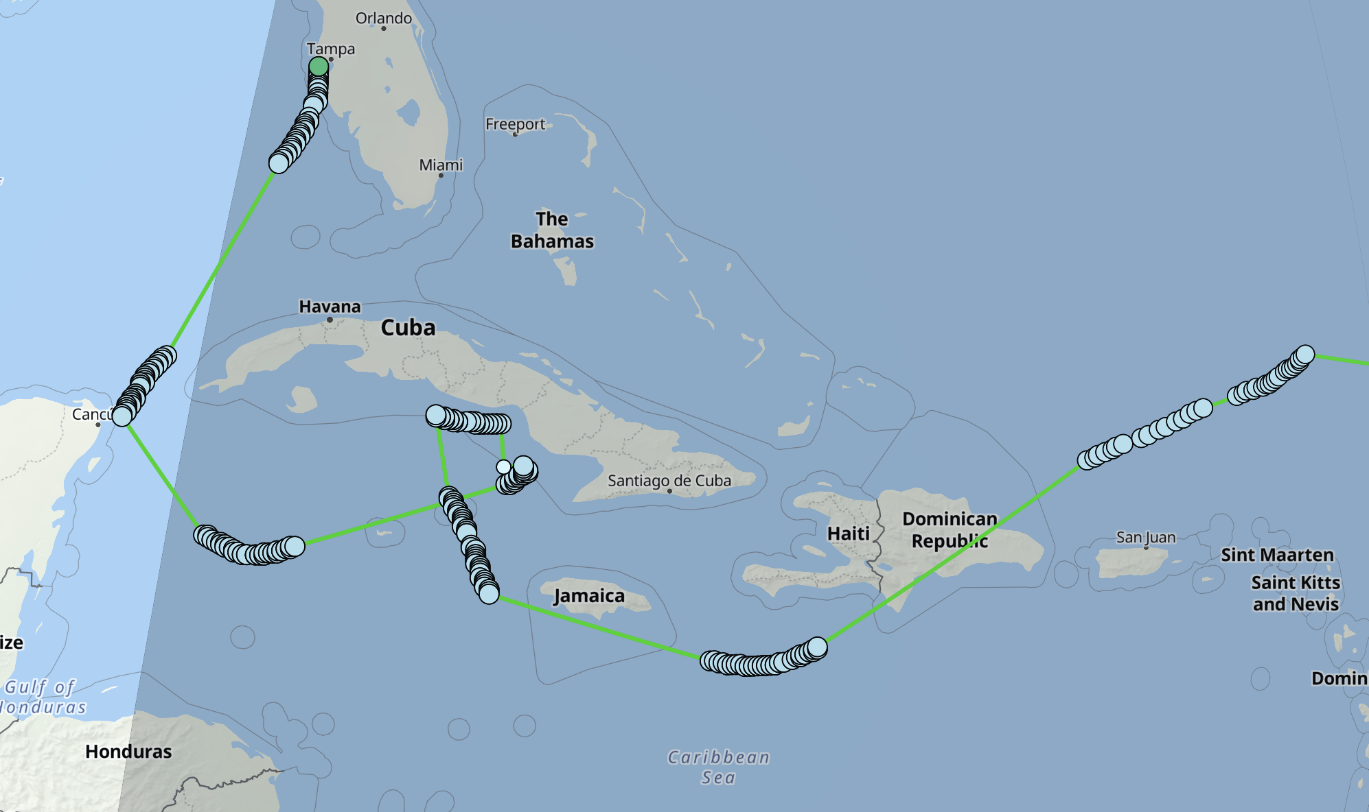

Slide 15
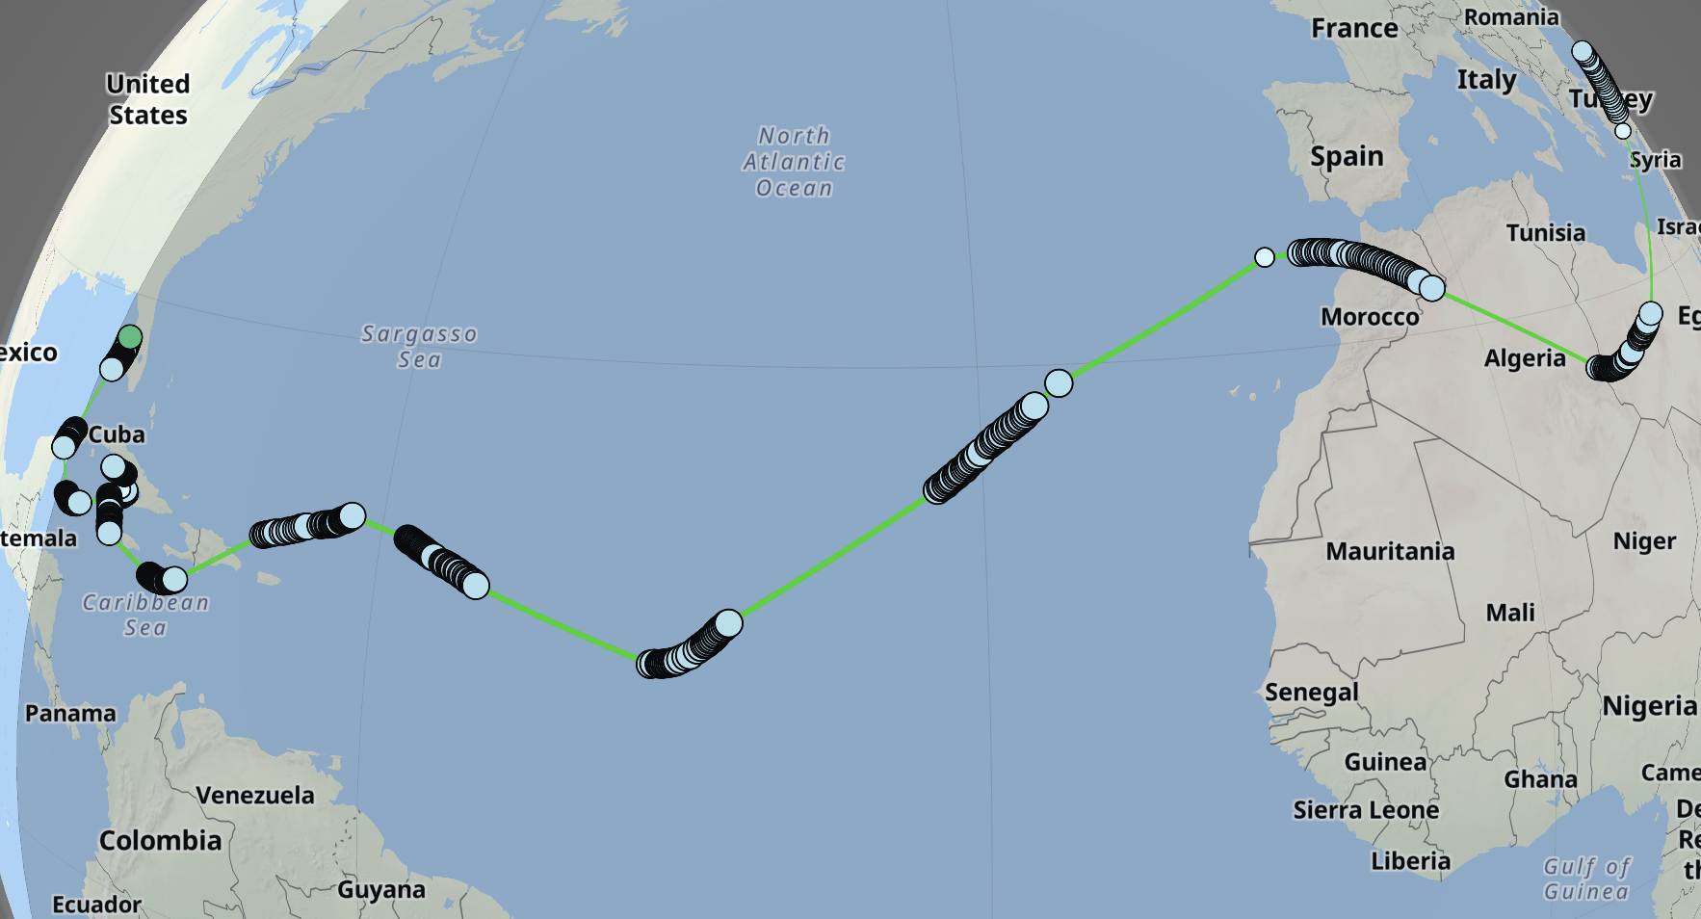

Slide 16
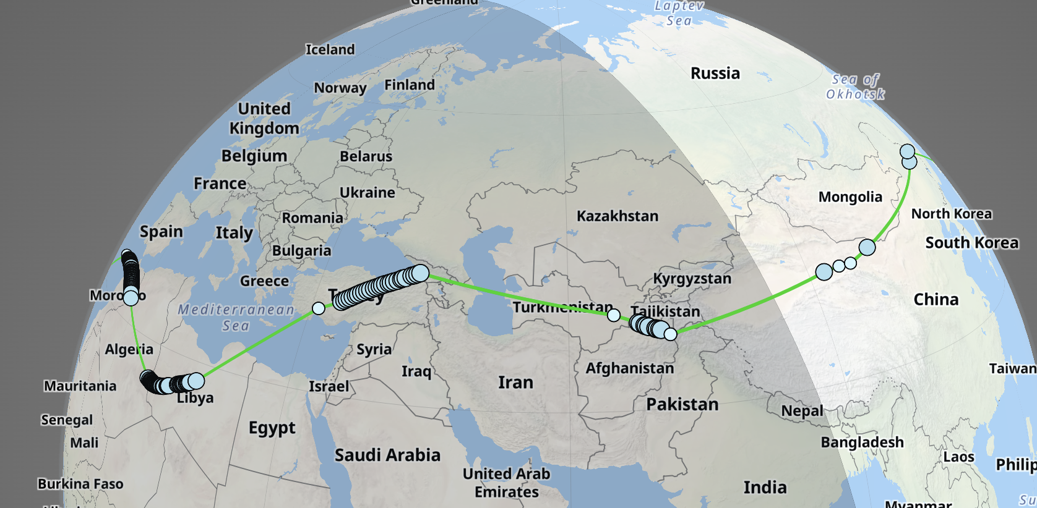

Slide 17
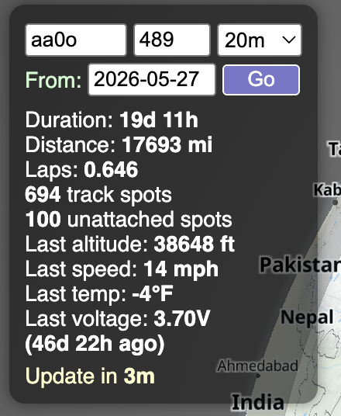
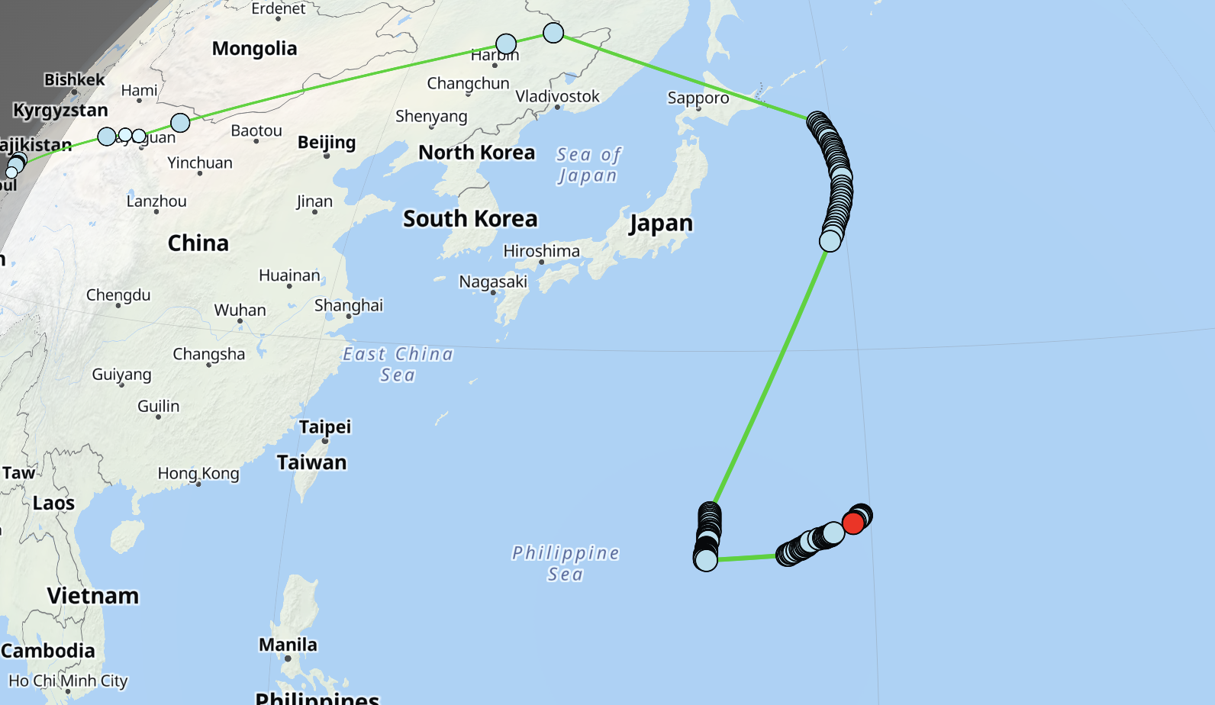
Notes:
units

Slide 18
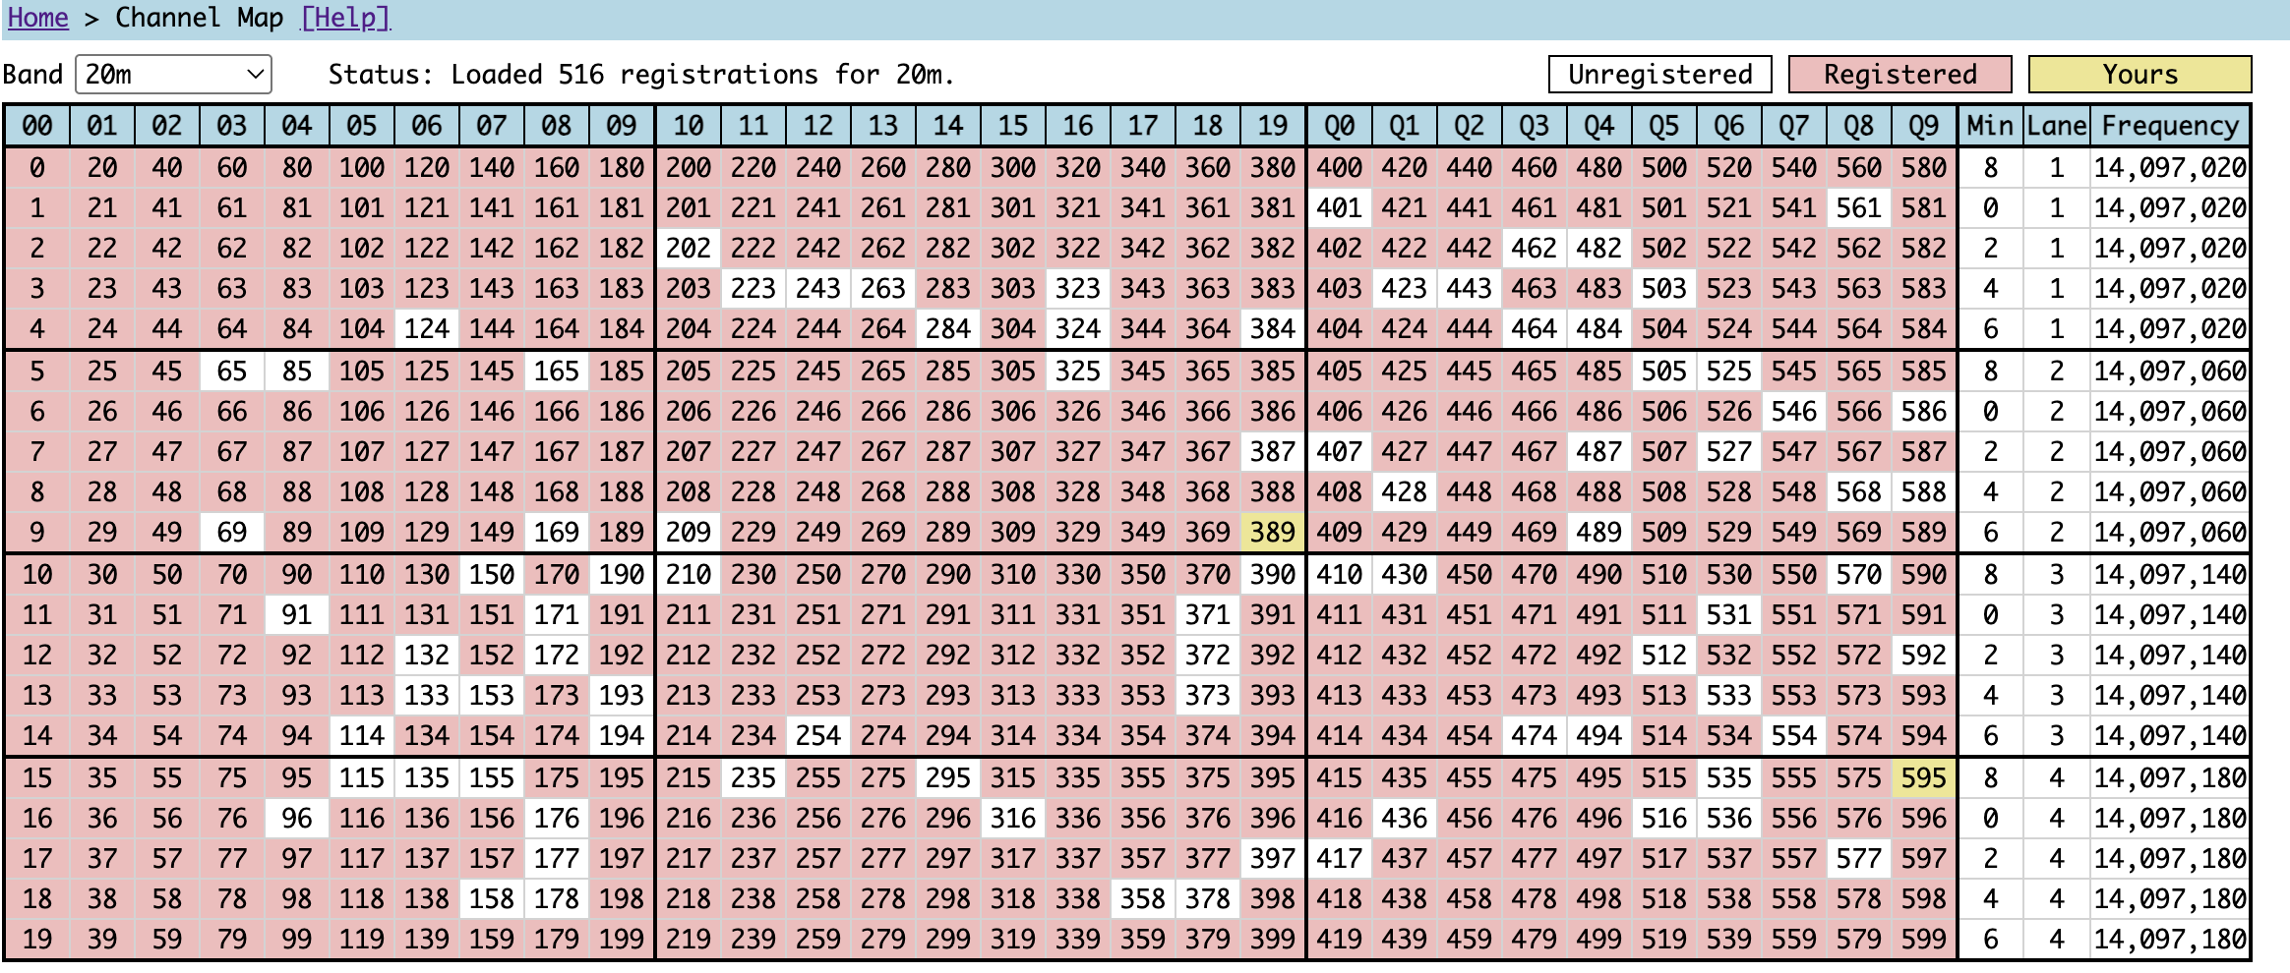
WSPR Channel MAP
Notes:
WSPR, 6hz, 110seconds, 4-FSK, 50bits between callsign, grid, tx pwr

Slide 19
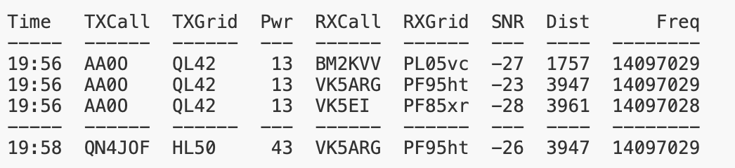
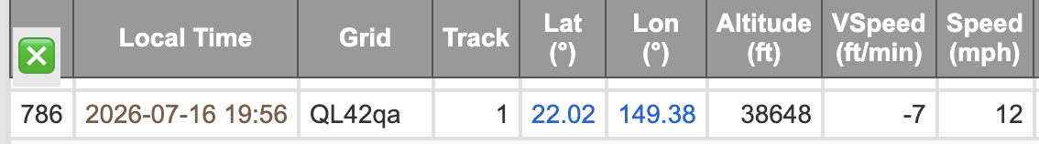
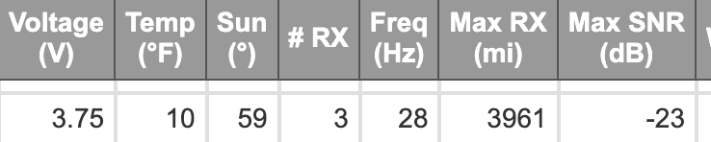
WSPR ENcoding
Transmit Regular WSPR message with callsign
Channel detected from that timestamp
Telemetry sent at +2 mins using encoding
Data fingerprinted from callsign transmission frequency

Slide 20
Other possibilities
Add a battery
Different tracker (integrated RP2040 chip)
Additional sensers (pressure, radiation, UV, solar, etc)
Different Digital Modes
Tiny camera

Slide 21

END
https://aa0o.radio

